Slide 1
Artificial Intelligence
Evaluation II

Slide 2
Overview
Head of School
New material: doing better at evaluation (saying how well our classifier is performing)

Slide 3
Second term topics: details
Data exploration and preparation (1 week)
We need to add some of the basic bits we skipped last term
Evaluation (2 weeks)
Really important: we all need to know the important methods for establishing exactly how well our ML methods are performing
Feature extraction (2 weeks)
Really interesting topic: if our data doesn’t have a really obvious consistent structure (e.g., text documents, images) then how should we extract features
Support Vector Machines (2 weeks)
A final “black box” technique we think you should have some exposure to (e.g., visualising, tuning hyperparameters)
Then over to Deep Learning with Nick (3 weeks, not assessed)

Slide 4
Evaluation (so far…)
Confusion matrices
Overall accuracy score
Last week: TPR/FPR
Last week: ROC curve
With better measures we can make better decisions (e.g., which classifier is best? What should the hyperparameters be? What can we reasonably expect in terms of future performance?)

Slide 5
Evaluation (doing better…)
Further steps to avoid overfitting: using a validation dataset
Doing repeated splitting for more robust (average) measures of performance: culminating with cross-validation
See for practice questions: cross-validation may take some time to understand but is quick and easy to just do with Matlab – so don’t be put off trying the questions, they’re some of the easier ones…
As last week, let’s have the Wisconsin biopsies dataset as our example
Classes are: ‘benign’ (no problem); ‘malignant’ (problem)

Slide 6


[Lecture 2:] Machine learning in practice
Data collection
We will usually need to rely on databases/spreadsheets compiled by others
Data exploration and preparation
Browse the data, make sure it contains no obvious errors
Model training
Pass data to a suitable machine learning algorithm to train a model
Model evaluation
Test how well the model performs on unseen data
Model improvement
Can we make changes to the training process to improve performance
After last week, we’re over half way through these final parts of the recipe

Slide 7
[Lecture 2:] Machine learning in practice
Data collection
We will usually need to rely on databases/spreadsheets compiled by others
Data exploration and preparation
Browse the data, make sure it contains no obvious errors
Model training
Pass data to a suitable machine learning algorithm to train a model
Model evaluation
Test how well the model performs on unseen data
Model improvement
Can we make changes to the training process to improve performance
By the end of this lecture we’ll have finished them

Slide 8

Digital Talent Day – companies looking for…
2D/3D Artist
Account Manager
Android Developer
Animator
Business Analyst
Business Development
Content Writer
Data Centre Technician
Data Scientist
Digital Designer
Digital Marketer
Front End Developer
Full Stack Developer
Graphic Designer
iOS Developer
Motion Graphics Designer
Network Engineer
Product Owner
Project Manager
Researcher
SEO Professional
Social Media Manager
Software Developer
Software Engineer
Solutions Architect
Strategist
Systems Engineer
Systems Administrator
Test Engineer
UX/UI Designer
Video Editor
Writer
https://www.eventbrite.com/e/talent-day-2019-studentjobseeker-registration-tickets-51780887027

Slide 9

Digital Talent Day – companies looking for…
2D/3D Artist
Account Manager
Android Developer
Animator
Business Analyst
Business Development
Content Writer
Data Centre Technician
Data Scientist
Digital Designer
Digital Marketer
Front End Developer
Full Stack Developer
Graphic Designer
iOS Developer
Motion Graphics Designer
Network Engineer
Product Owner
Project Manager
Researcher
SEO Professional
Social Media Manager
Software Developer
Software Engineer
Solutions Architect
Strategist
Systems Engineer
Systems Administrator
Test Engineer
UX/UI Designer
Video Editor
Writer
https://www.eventbrite.com/e/talent-day-2019-studentjobseeker-registration-tickets-51780887027

Slide 10
Model evaluation and improvement
The last two steps in the recipe merge together
We want to see how well a model performs in order to improve it
The big picture is typically: how well can we get different models to perform, and therefore which one should we use in future?
Let’s remind ourselves of some of the context from lecture 2…

Slide 11
[Lecture 2:] Which is best?
Difficult question to answer
Different performance on different datasets
They each have their own “style” – use particular rules (heuristics) to identify the most useful patterns for future (generalisation)
As Computer Science students, we want to build a sense of each model, how it works, and what it offers
But ultimately, it’s usually necessary to try them out on your data

Slide 12
[Lecture 2:] Which is best?
Great, try all 3 and use the best?
More complicated than that, because you can train each model in lots of different ways
Models have:
Parameters – which are learned from your data during training
Hyperparameters – which are set by you before training and remain fixed
Each algorithm gives you access to an entire “family” of models
Generally end up testing multiple different versions of each model

Slide 13
[Lecture 2:] What am I looking for?
You’re looking for the model that will perform reliably in the real world (will reliably inform future actions)
E.g., if you hand it over to a doctor at the clinic tomorrow…
It starts to see new blood samples…
…And makes good decisions, allowing treatments to be targeted appropriately
This is the model that does best at explaining the real-world process underlying your data
Not necessarily the model that does best at explaining the data itself

Slide 14
Class 1
Class 2
Feature 2
Feature 1

Slide 15
Class 1
Class 2
Feature 2
Is this better?
Feature 1

Slide 16
[Lecture 2:] Avoid overfitting
The general advice is not to work too hard to explain the fine details in your training data
Treat your training data with some suspicion
Assume that it could contain errors, or data which is not representative (see Lantz’ definition of “noisy” data)
Don't let a couple of data points influence your entire explanation
This is called overfitting your training data
It can lead to poor future performance on unseen data

Slide 17
[Lecture 2:] Withhold testing data
A good way to make sure you’re not overfitting
Withhold some of your data: “holdout” method
Set it aside right at the start, before you do anything else
Use it for evaluating the performance of the models you train
Not a perfect solution, but good enough for us while we learn about the more interesting things…

Slide 18
Exam preparation: step 1
See for practice questions: Everyone needs to be confident using a simple holdout approach to evaluate the performance of one classifier with a particular choice of hyperparameters…
Make sure you have tried the “Performance evaluation: holdout” question before you attempt any of this week’s questions

Slide 19
Going further…
We’re going to look at some new approaches to splitting the data
Will be helpful to visualise the data
Let’s develop a simple visualisation based on the colour-coding used in the early lectures…

Slide 20
[Lecture 2:] Example dataset
Radius mean | Texture mean | Perimeter mean | Diagnosis | Smoothness mean
17.99 | 10.38 | 122.8 | Benign | 0.1184
20.57 | 17.77 | 132.9 | Malignant | 0.08474
19.69 | 21.25 | 130.0 | Benign | 0.1096
Area mean | Compactness mean
1001 | 0.3001
1326 | 0.0869
1203 | 0.1974
Diagnosis
Benign
Malignant
Benign
…
…

Slide 21
[Lecture 3:] Example dataset
“Training data”
Radius mean | Texture mean | Perimeter mean | Diagnosis | Smoothness mean
17.99 | 10.38 | 122.8 | Benign | 0.1184
20.57 | 17.77 | 132.9 | Malignant | 0.08474
19.69 | 21.25 | 130.0 | Benign | 0.1096
Area mean | Compactness mean
1001 | 0.3001
1326 | 0.0869
1203 | 0.1974
Diagnosis
Benign
Malignant
Benign
…
…
“Testing data”
Radius mean | Texture mean | Perimeter mean | Diagnosis | Smoothness mean
14.82 | 11.21 | 132.8 | Benign | 0.2142
18.75 | 16.65 | 122.1 | Malignant | 0.0751
18. 98 | 20.35 | 129.2 | Benign | 0.2013
Area mean | Compactness mean
998 | 0.2911
1035 | 0.0913
1236 | 0.1847
Diagnosis
Malignant
Benign
Benign
…
…

Slide 22
[Lecture 3:] Example dataset
“Training data”
Radius mean | Texture mean | Perimeter mean | Diagnosis | Smoothness mean
17.99 | 10.38 | 122.8 | Benign | 0.1184
20.57 | 17.77 | 132.9 | Malignant | 0.08474
19.69 | 21.25 | 130.0 | Benign | 0.1096
Area mean | Compactness mean
1001 | 0.3001
1326 | 0.0869
1203 | 0.1974
Diagnosis
Benign
Malignant
Benign
…
…
“Testing data”
Radius mean | Texture mean | Perimeter mean | Diagnosis | Smoothness mean
14.82 | 11.21 | 132.8 | Benign | 0.2142
18.75 | 16.65 | 122.1 | Malignant | 0.0751
18. 98 | 20.35 | 129.2 | Benign | 0.2013
Area mean | Compactness mean
998 | 0.2911
1035 | 0.0913
1236 | 0.1847
Diagnosis
Malignant
Benign
Benign
…
…

Slide 23
[Lecture 3:] Example dataset
“Training data”
“Testing data”

Slide 24
[Lecture 3:] Example dataset
“Training data”
“Testing data”

Slide 25
[Lecture 3:] Example dataset
“Training data”
“Testing data”
Let’s flip this on its side for better use of space…

Slide 26
[Lecture 3:] Example dataset
“Training data”
“Testing data”

Slide 27
[Lecture 3:] Example dataset
“Training data”
“Testing data”
And adjust the relative proportions to reflect a more realistic division…

Slide 28
[Lecture 3:] Example dataset
“Training data”
“Testing data”

Slide 29
[Lecture 3:] Example dataset
“Training data”
“Testing data”
A typical holdout split might be: 80% training data, 20% testing data…

Slide 30
Holdout: the motivation
Remember why we’re using holdout…
We’re concerned about overfitting the training data
So let’s set aside some fraction of the data we have just for testing
Use the rest for training
Hopefully, if we go too far in trying to capture the fine details of the training data, this will be revealed by poor performance on the testing data

Slide 31
Holdout: potential problems
“For the holdout method to result in a truly accurate estimate of the future performance, at no time should the performance on the test dataset be allowed to influence the model.” Lantz, Chapter 10

Slide 32
Holdout: potential problems
Potential problems can come when we want to start looking at model improvement using holdout
If you go round and round between training (on one set of data) and testing (on the other set of data)…
…Trying very hard to maximise performance on the latter (e.g., overall accuracy, TPR/FPR, AUC, etc.)…
…You allow the performance on the test dataset to influence the model
Sometimes referred to as data leakage – using information from outside the training data to create the model
Data leakage re-introduces the risk of overfitting

Slide 33
Holdout: new approach
In the scenario where you want to do repeated testing (e.g., to tune hyperparameters)…
…We need to do a better job of protecting against overfitting
Two step solution:
Step 1: strictly set the testing data aside
Step 2: perform holdout within your training data

Slide 34
Holdout: new approach
Step 1: strictly set the testing data aside
You’ll never use it until you’ve finalised all your decisions about which models to use and which hyperparameter settings are the best…
…Right at the very end…
…You’ll use the testing data to calculate an estimate of likely future performance
[And if it’s lower than what you were hoping/expecting, you’ll resist the urge to go back and start tuning again…]

Slide 35
Holdout: new approach
Step 2: perform holdout within your training data
Further divide the training data into two smaller segments
One for repeated training… becomes the new “training data”
One for repeated testing… usually called “validation data”
Can perform repeated training/testing between these two parts of the data to make [sensible/informed*] decisions...
E.g., about the choice of hyperparameter values
E.g., about k-NN versus DTs versus NB

Slide 36
Holdout: new approach
* You could just allow data leakage from the validation dataset…
…But…
You don’t want to because you know overfitting is a bad strategy for obtaining good future performance
And it will be revealed by the final results on the testing dataset
The overall approach “keeps you honest”

Slide 37
Holdout: new approach
Once you’ve finalised your decisions (e.g., K-NN with k=15 is the best choice)…
…Re-train a final model on your training data PLUS your validation data…
And run a final performance evaluation on the testing data you set aside

Slide 38
Example dataset
“Training data”
“Validation data”
“Testing data”
“The validation dataset [is] used for iterating and refining the model or models chosen, leaving the test dataset to be used only once as a final step to report an estimated error rate for future predictions.” [Lantz, Chapter 10]

Slide 39
Example dataset
“Training data”
“Validation data”
“Testing data”
We’re going to develop this idea further… Let’s colour code the labels to be clear they describe any portion of the original dataset that has the same colour…

Slide 40
Example dataset
“Training data”
“Validation data”
“Testing data”
We’re going to develop this idea further… Let’s colour code the labels to be clear they describe any portion of the original dataset that has the same colour…

Slide 41
Example dataset
“Training data”
“Validation data”
“Testing data”
We’re going to develop this idea further… Let’s colour code the labels to be clear they describe any portion of the original dataset that has the same colour…

Slide 42
Holdout: doing better
We still effectively have a “holdout” approach…
…Just we have ‘insured’ against overfitting with an extra partition
Are there any other steps we can take to improve our new “holdout” approach?

Slide 43
Holdout: doing better
“Training data”
“Validation data”
“Testing data”
We’re going to focus in on this bit for a while…

Slide 44
Holdout: doing better
“Training data”
“Validation data”
“Testing data”
We’re going to focus in on this bit for a while…
But we’re still keeping this bit safe and we’ll come back to use it…

Slide 45
Holdout: doing better
One idea quite a few people have raised in labs:
The split we make is random (it follows a shuffle)
It could be unrepresentative (e.g., it’s possible you could sample only benign examples)
Wouldn’t it be better to split randomly multiple different times, train and test multiple versions of the model, and average the performance measures?

Slide 46
Holdout: doing better
1. Shuffle all the data:

Slide 47
Holdout: doing better
1. Shuffle all the data:
“Training data”
“Validation data”
2. Split it:

Slide 48
Holdout: doing better
1. Shuffle all the data:
“Training data”
“Validation data”
2. Split it:
“Training data”
3. Train a model:
M

Slide 49
Holdout: doing better
1. Shuffle all the data:
“Training data”
“Validation data”
2. Split it:
“Training data”
3. Train a model:
M
“Validation data”
4. Test the model:
M
Performance measure

Slide 50
Holdout: doing better
Repeat
1. Shuffle all the data:
“Training data”
“Validation data”
2. Split it:
“Training data”
3. Train a model:
M
“Validation data”
4. Test the model:
M
Performance measure

Slide 51
Holdout: doing better
Repeat
1. Shuffle all the data:
“Training data”
“Validation data”
2. Split it:
“Training data”
3. Train a model:
M
“Validation data”
4. Test the model:
M
Performance measure
For example, repeat 5 times to produce: 5 different random splits; 5 different models (same algorithm, same hyperparameters) trained from 5 different sets of training data; 5 different performance measures (same metric) computed from 5 different sets of validation data… [Finally, calculate an overall average]

Slide 52
Holdout: doing better
Called: repeated holdout testing
Was the default approach for many years
Make decisions (e.g., about hyperparameters) based on an average measure of performance across all of your repetitions
At the end, retrain on the all the data you were using for training/validation, and…
…Do one final test on your testing data

Slide 53
Holdout: doing better
Retrain on all the data using the model/hyperparameters you have decided on:
M*
Do one final test on the testing data partition you set aside at the start:
“Testing data”
M*
Final performance measure

Slide 54
Holdout: doing better
Repeated holdout testing is better, but still has problems…
We end up with some examples used multiple times in the testing process…
…And some examples not used at all
As a result, some examples have a greater impact on your performance measure
Solution is k-fold cross-validation

Slide 55
K-fold cross-validation
Divide the original training partition into k disjoint (non-overlapping) parts, or “folds”, of the same size
Train k different models on (k-1) parts, testing them on the remaining part
Ensures you use every example equally often for training and exactly once for testing

Slide 56
Example: 5-fold cross-validation
1. Shuffle all the data:

Slide 57
Example: 5-fold cross-validation
2. Divide into equal ‘folds’:
Fold 1
Fold 2
Fold 3
Fold 4
Fold 5

Slide 58
Example: 5-fold cross-validation
= “Validation data”
= “Training data”
Use fold 1 for validation:
Fold 1
Fold 2
Fold 3
Fold 4
Fold 5

Slide 59
Example: 5-fold cross-validation
= “Validation data”
= “Training data”
Use fold 2 for validation:
Fold 1
Fold 2
Fold 3
Fold 4
Fold 5

Slide 60
Example: 5-fold cross-validation
= “Validation data”
= “Training data”
Use fold 3 for validation:
Fold 1
Fold 2
Fold 3
Fold 4
Fold 5

Slide 61
Example: 5-fold cross-validation
= “Validation data”
= “Training data”
Use fold 4 for validation:
Fold 1
Fold 2
Fold 3
Fold 4
Fold 5

Slide 62
Example: 5-fold cross-validation
= “Validation data”
= “Training data”
Use fold 5 for validation:
Fold 1
Fold 2
Fold 3
Fold 4
Fold 5

Slide 63
K-fold cross-validation
K-fold cross-validation has become the “gold standard” in evaluation
See for practice questions: k=10 generally gives good results
Make decisions (e.g., about hyperparameters) based on an average measure of performance across your k models
At the end, retrain on the all the data you were using for training/validation, and…
…Do one final test on your testing data

Slide 64
K-fold cross-validation
Retrain on all the data using the model/hyperparameters you have decided on:
M*
Do one final test on the testing data partition you set aside at the start:
“Testing data”
M*
Final performance measure

Slide 65
Exam preparation: part 2
See for practice questions: Be ready to use cross-validation in any questions where you are asked to perform repeated testing in order to make a decision, e.g.:
“Which classifier is best…”
“Which value for this hyperparameter is best…”
(The question will usually have already done the initial split for you… And will usually suggest that you use cross validation on the non-testing portion) ->
When passing that portion of the data to a fitc*() function, you can simply add (…,‘KFold’,10,…)– really easy! ☺

Slide 66
Exam preparation: part 2
The object you get back will contain all of the k=10 different models! (You can access them through the .Trained property)
…And details of the associated partitions (You can access them through the .Partition property
So you could dip in and do things like calculate specific performance measures (e.g., AUC)
…But Matlab offers a built-in functions for extracting averages of common measures
See for practice questions: using these built-in functions is always sufficient measure of performance for the exam (see next slide)

Slide 67
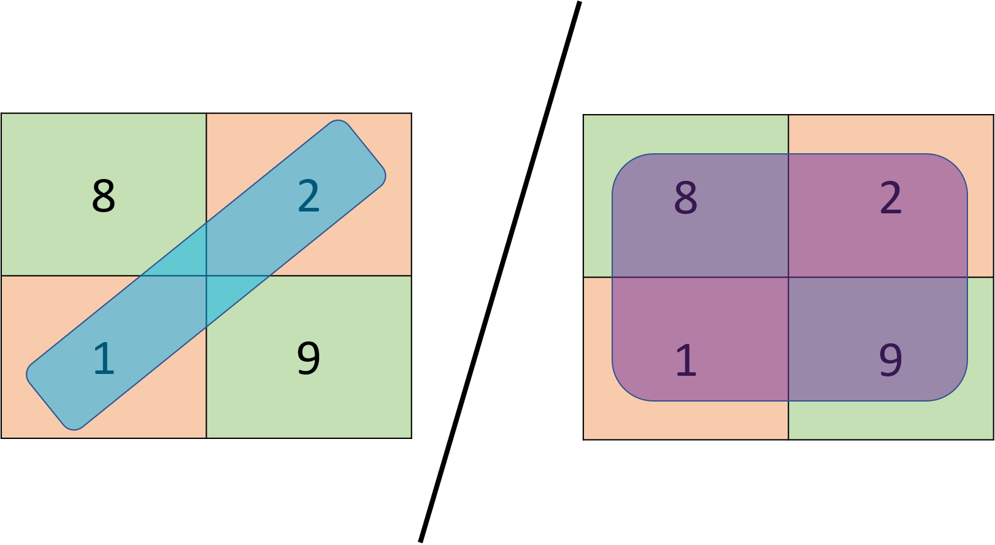
Average Loss
We’ve looked a lot at the overall classification accuracy, or rate
The “loss” is just the overall misclassification rate
For any confusion matrix:
(sum of the off-diagonal elements) / (sum of all the elements)
Or just 1-(classification accuracy)
See for practice questions: the kfoldLoss() function will give you the average loss across your k models, as a useful single-number measure of performance
Just be careful, for loss: LOWER IS BETTER

Slide 68
Cross-validation: randomness
When you call with …,‘KFold’,10,…
What Matlab does behind the scenes is to make a cvpartition object which holds details of all the different folds
Matlab handles the shuffling of your data when it makes this object
Two implications:
You wouldn’t need to have shuffled the data for yourself – but it wouldn’t matter if you did…
You’ll get different results (e.g., from kfoldLoss) every time you call with …,‘KFold’,10,… (unless you’re resetting the random number generator)

Slide 69
Next steps…
Try the practice exam questions
They require the use of cross-validation
Use the red suggestions in the previous slides to help guide you
Don’t give up too easily…
Is supposed to require a little research/playing around/testing things out
Helps build stronger memories

Slide 70
1EXAM50: golden rule
If you do all the practice questions…
(And understand what you’re doing – i.e., don’t just copy the answers from someone else)
Then there’s no reason why you can’t get 100% on the exam

Slide 71
For interest
The information in the remaining slides is for interest only
Not examined
Might be useful if you’re using ML for your project
Or working with ML/Matlab in the future

Slide 72
Stratified sampling
Randomly choosing the partitions (i.e., shuffling first) works well if you have an equal number of examples from each class…
But if you have one class that is much smaller…
E.g., you have 1000 ‘Benign’ samples, but only 50 ‘Malignant’ examples
Then you could potentially end up with folds that don’t contain any of those examples
Stratified sampling tries to ensure that the original balance between classes is maintained in each of your folds
There are two different ways to make a cvpartition object in Matlab; one will give you stratified sampling, the other won’t…

Slide 73
Cross-validation: randomness
The docs for calling a fitc*() function with …,‘KFold’,k,…
“If you specify 'KFold',k, then the software completes these steps.
Randomly partition the data into k sets.
For each set, reserve the set as validation data, and train the model using the other k – 1 sets…”
I decided to double check step 1 and actually it wasn’t true…
The partitions do use stratified sampling
Conclusion: nothing to worry about (it’s good!); if you’re making the initial split before using cross-validation then it would be good to make sure it is stratified (see cvpartition’s ‘Holdout’ option)

Slide 74
Cross-validation for hyperparameters
A typical use of cross-validation is in decisions about the values of hyperparameters
Good approach: use cross-validation to compute a kfoldLoss value for each of a range of different values of a hyperparameter
E.g., for k in a k-NN classifier: k=1, k=3, k=5, …, k=15
Select whichever value of the hyperparameter gives the lowest average loss…
Loss
Value of k

Slide 75
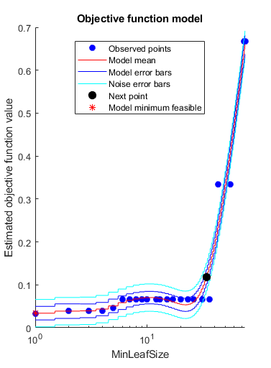
Cross-validation for hyperparameters
Actually, you can ask Matlab’s fitc*() fns. to do this kind of hyperparameter tuning for you
See the ‘OptimizeParameters’ option, which uses 5-fold cross-validation by default
Here for minimum leaf size in a decision tree model
The y-axis is showing loss
https://uk.mathworks.com/help/stats/fitctree.html

Slide 76
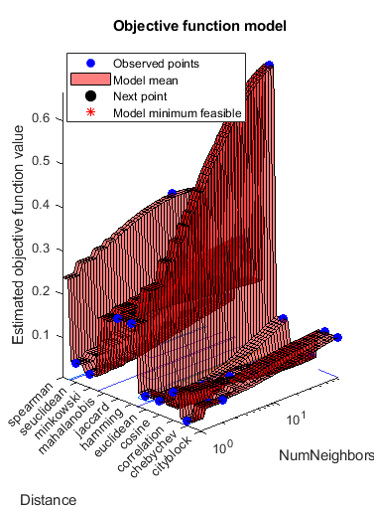
Cross-validation for hyperparameters
Actually, you can ask Matlab’s fitc*() fns. to do this kind of hyperparameter tuning for you
See the ‘OptimizeParameters’ option, which uses 5-fold cross-validation by default
Here for both the distance measure and the number of neighbours in a k-NN model
The y-axis is showing loss
https://uk.mathworks.com/help/stats/fitcknn.html

Slide 77
Reading for next week
Brett Lantz, “Machine Learning with R”
Chapter 4: “Probabilistic Learning – Classification using Naïve Bayes”
From the section entitled: “Example – filtering mobile phone spam with the Naïve Bayes algorithm”
Up to the end of the chapter
Suggested approach (but do whatever works best for you):
Just relax and read through [could almost skim…]
As ever, we’re interested in the ideas, not the use of R
The main interesting new idea is the “bag-of-words” approach

